Slide 1
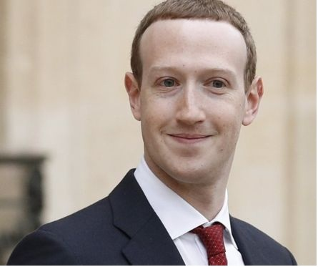
WELCOME TO ALL
Presented by :-Achal Gupta and Gyanpraksh Gupta

Slide 2
About mark zuckerberg
Its full name is Mark Elliot Zuckerberg.
Born in may 14,1984 in white plains, new work.
Grew up in Dobbs Fury, New York.
His dad were a dentist and mother were a doctor.

Slide 3
Program he created
Zucknet
Synapse media player
Course match
Face mash

Slide 4
What he make and do
Mark Elliot Zuckerberg co- founder and chief executive of facebook.
He launched facebook on febuary 4, 2004 with its roommates Eduardo Saverin, Andrew Mccollum, Dustin Moskovitz and Chris Hughes .
He holds 28.4% shareholding of facebook.

Slide 5

Facebook app & logo

Slide 6
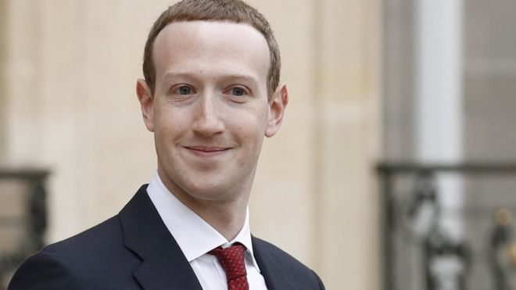
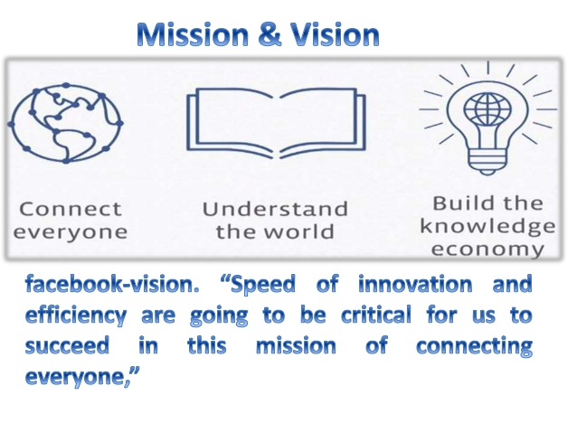
Mission & Vision

Slide 7
REASON for choosing facebook
Markzukerberg is a source
of inspiration for many of the
youth enterpreneurs across
the globe. He has given the
tag as next Bill Gates HIMself.

Slide 8
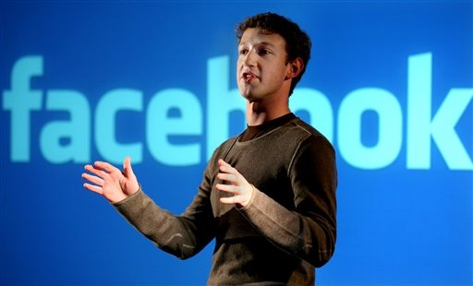
Why Facebook, and Mark Zuckerberg are so successful
1 Mark Zuckerberg took a big risk because he dropped out of college, to start Facebook. If Facebook was not as successful as it is, he might of regretted that decision.
2 Kids like talking, and playing games, and Facebook is just the thing for us kids.

Slide 9

General information about facebook
Facebook has more than900 million active user.
With 157 million members, the united states has the most facebook users.
Facebook says it had an average 526 million active users per day.
More than 300 million photos are uploded on facebook.

Slide 10
Mark zuckerberg visit india in October 2018 ,meet PM Narender Modi.
1 Mark push for internet.org in india.
2 Joining hand with swatch baharat abhiyaan.
3 Strengthening the business conifidence in india for facebook.
4 Stronger tie with the government.

Slide 11
The End!
HOPE YOU ENJOYED our PRESTENTATION!!!!
THANK YOU!!!

